Slide 1




The session will be starting soon
.com/Microsoft-Reactor-Abu-Dhabi
#ReactorAbuDhabi
@MSFTReactor
/MicrosoftReactor

Slide 2
Application Modernisation
Event Code: #11812
Niel Zeeman @teamfoundation

Slide 3




The Monolith
Payment Gateway
Authentication
Static Site (Glossies)
Order Submission
User
Warehouse (Order fulfillment)
Catalogue
Cart / Checkout
Payment Process
Comms Gateway
History
Meetup link: meetup.com/Microsoft-Reactor-Abu-Dhabi

Slide 4
The Monolith : Legacy?
It works
No big updates in the last number years
Probably 2/3 tier architecture
Meetup link: meetup.com/Microsoft-Reactor-Abu-Dhabi

Slide 5
The Monolith : Legacy!
Difficult to change
Error prone
Few tests (if any)
Slow
Can’t scale
3rd party integration updated/expensive
Security
It just not cool….
Time/Effort to
change or fix
Time since development started
Meetup link: meetup.com/Microsoft-Reactor-Abu-Dhabi

Slide 6
Modern Applications
Microservices
Containers
Cloud
Serverless
ML / AI
Make it someone else’s problem
Agile/DevOps
Meetup link: meetup.com/Microsoft-Reactor-Abu-Dhabi

Slide 7
The Monolith
Payment Gateway
Authentication
Static Site (Glossies)
Order Submission
User
Warehouse (Order fulfillment)
Catalogue
Cart / Checkout
Payment Process
Comms Gateway
History

Slide 8
The Transition..
Payment Gateway
Authentication
Static Site (Glossies)
Order Submission
User
Warehouse (Order fulfillment)
Catalogue
Payment Process
Cart / Checkout
Comms Gateway
History

Slide 9
The Transition..
Authentication
Payment Gateway
User
History
Static Site (Glossies)
Warehouse (Order fulfillment)
Catalogue
Cart / Checkout
Payment Process
Comms Gateway
Order Submission

Slide 10


The Transition..
Authentication
Authentication
Payment Gateway
User
History
Static Site (Glossies)
Warehouse (Order fulfillment)
Catalogue
Cart / Checkout
Payment Process
Comms Gateway
Order Submission

Slide 11


The Transition..
Authentication
Payment Gateway
User
History
Static Site (Glossies)
Static Pages
Warehouse (Order fulfillment)
Catalogue
Cart / Checkout
Payment Process
Comms Gateway
Order Submission

Slide 12
The Transition..
Authentication
Payment Gateway
User
History
Static Pages
Warehouse (Order fulfillment)
Catalogue
Cart / Checkout
Payment Process
Comms Gateway
Order Submission

Slide 13












The Catalogue
Catalogue
Web
Images
Monitor
Cache
Search

Slide 14
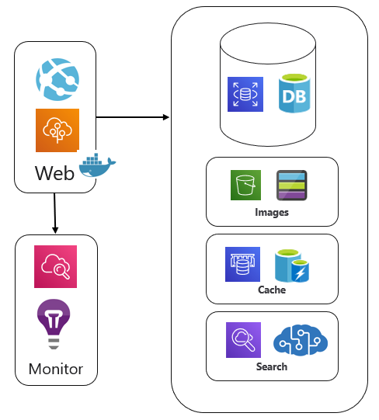
The Transition..
Authentication
Payment Gateway
User
History
Static Pages
Warehouse (Order fulfillment)
Catalogue
Cart / Checkout
Payment Process
Comms Gateway
Order Submission

Slide 15




The Cart
Cart / Checkout
Web
Queue
Monitor

Slide 16
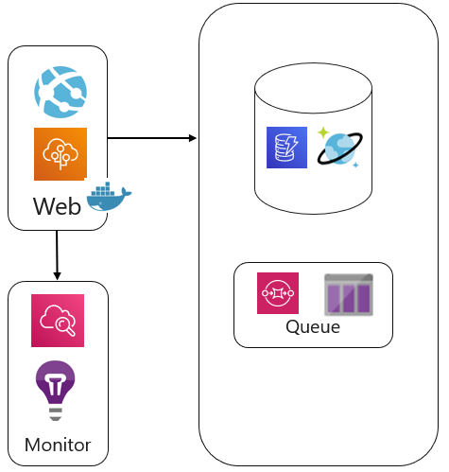


The Transition..
Authentication
Payment Gateway
User
History
Static Pages
Warehouse (Order fulfillment)
Catalogue
Cart / Checkout
Payment Process
Payment Process
Comms Gateway
Order Submission

Slide 17



The Order Process
Order Submission
Warehouse System Interface
Warehouse System
Queue
Communication

Slide 18


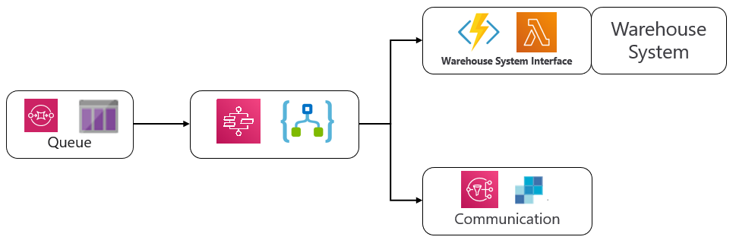
The Transition..
Authentication
Payment Gateway
User
History
History
Static Pages
Catalogue
Cart / Checkout
Payment Process
Comms Gateway
Order Submission

Slide 19
The Transition..
Authentication
Payment Gateway
User
History
Static Pages
Catalogue
Cart / Checkout
Payment Process
Comms Gateway
Order Submission

Slide 20




The Transition..
Authentication
CDN
User
Payment Gateway
History
Static Pages
API Gateway
Catalogue
Cart / Checkout
Payment Process
Comms Gateway
Order Submission

Slide 21






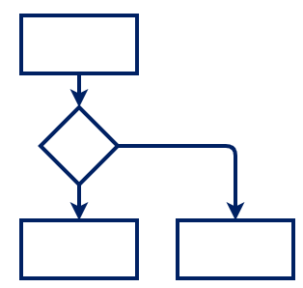











The Transition..
CDN
Auth
Global Access Point
Web
Queue
Workflow
Gateway
Functions
3rd Party

Slide 22










The Transition..
CDN
Auth
Global Access Point
Web
Queue
Workflow
Gateway
Functions
3rd Party
CLI

Slide 23
The Transition..
CDN
Auth
Global Access Point
Web
Queue
Workflow
Gateway
Functions
3rd Party
CLI

Slide 24
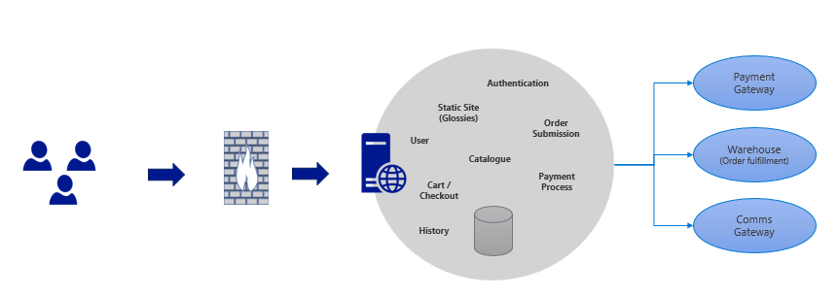
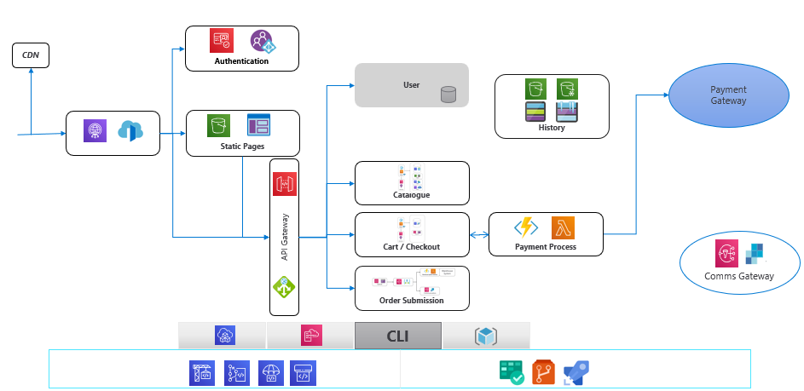
Thank You!
Q&A
Niel Zeeman @teamfoundation
meetup.com/Microsoft-Reactor-Abu-Dhabi
@MSFTReactor
http://www.youtube.com/c/MicrosoftReactor
Meetup link: meetup.com/Microsoft-Reactor-Abu-Dhabi
aka.ms/ReactorEmailSignUp

Slide 25
Please enter the event code 11812 at the start of survey
We are constantly striving to create excellent content and would appreciate if you could take this brief survey.
Survey Link: https://aka.ms/Reactor/Survey
Meetup link: meetup.com/Microsoft-Reactor-Abu-Dhabi

